Slide 1
Master Thesis Object Detection Using Transformer Fusion And Detection Transformer On Multi-Sensor Data For Automated Driving
Anshu Garg
a_garg19@cs.uni-kl.de
Supervisor: David Michael Fürst
Professor: Prof. Dr. Didier Stricker

Slide 2
Outline
Motivation
Related Work
Research Gaps
Methodology
Experiments
Qualitative Results
Conclusion and Future Work
References

Slide 3
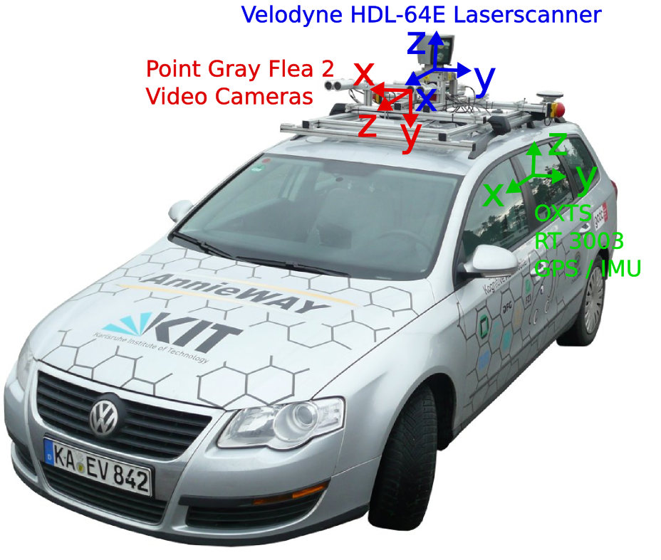
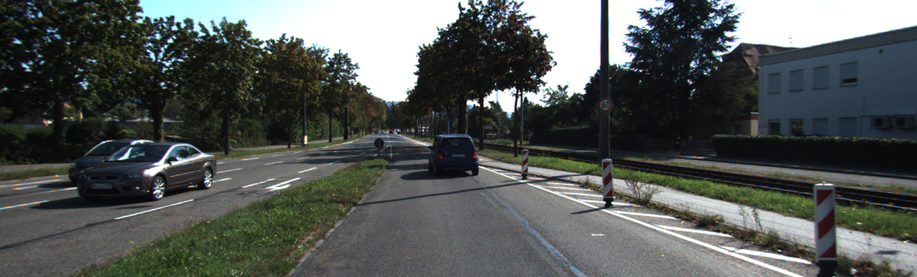
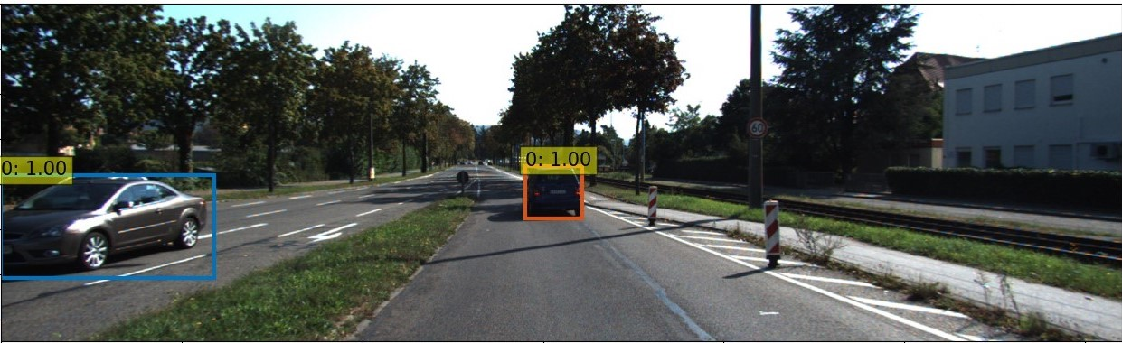
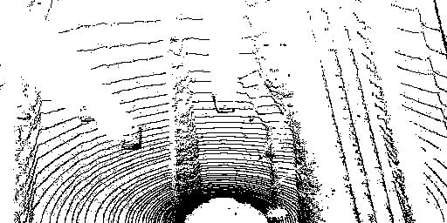
Motivation
Model: TransFuserDeTr (TransFuser¹ + DeTr²)
Task: End-to-end 2D Object Detection
Sensors: Camera and LiDAR
Data: RGB and BEV image (no calibration)
Dataset: Kitti³
A.Prakash et al. “Multimodal fusion transformer for end-to-end autonomous driving” (CVPR), 2021.
N.Carion et al. “End-to-end object detection with transformers” (ECCV), 2020.
A.Geiger et al. “Vision meets robotics: The kitti dataset” (IJRR), 2013.
Motivation
Notes:
Use of transformers in object detection.

Slide 4
Outline
Motivation
Related Work
Research Gaps
Methodology
Experiments
Qualitative Results
Conclusion and Future Work
References

Slide 5
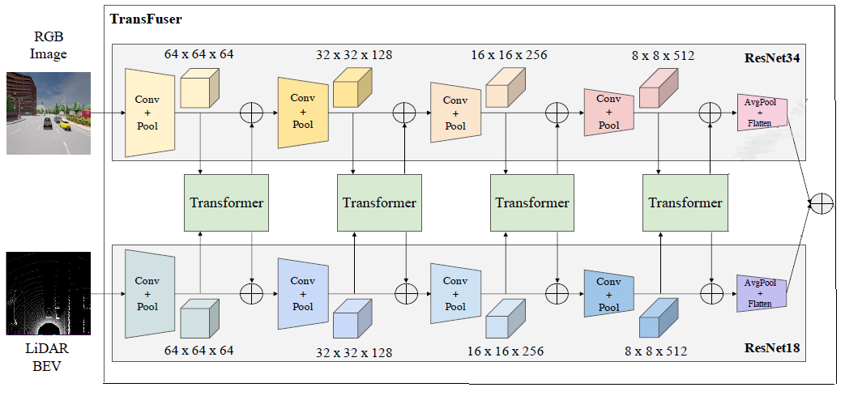
Transformer Fusion (TransFuser)
RGB Image Encoder
BEV Image Encoder
Task: Waypoint Prediction
Deep and slow fusion on multi-sensor data by attention menchanism using Transformer.
Outputs global context feature vector.
Related Work
Notes:
Model predicts waypoint, which decides the driving policy to be adopted depending upon the surroundings data provided by sensors.
Attention mechanism is applied multiple times.
Individual feature map of each modality is considered as a set rather than spatial grid. And each element of the set is considered as a token.
Both features encodes different aspects of the scene at different layers, hence fusion is performed at multiple scales.
Number of modalities = S,
Shape of each modality = H*W*C
For all modalities S, features are stacked together to form a sequence of dimension (S*H*W) *C. Here, (S*H*W) is flattened feature map. This is concatenation of both modality features rather than element-wise-summation.
Position Embedding of same size (S*H*W) is added with feature vector to provide spatial dependencies between different tokens.

Slide 6
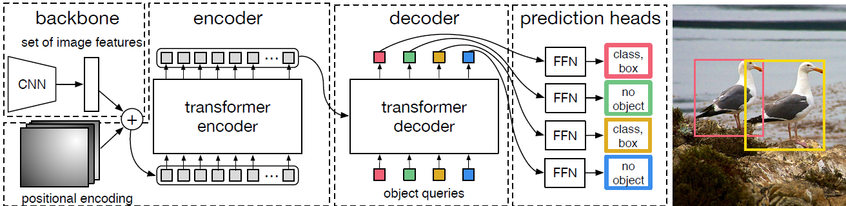
Detection Transformer (DeTr)
Task: End-to-end 2D Object Detection.
Idea: Considers object detection as set prediction problem.
CNN: ResNet50.
1x1 conv. reduces feature map size (input_proj).
Encoder‘s positional encoding: Sine/ Learned.
Standard Encoder and Decoder Transformer (decodes N objects in parallel).
Related Work
Notes:
Highlight backbone.
NestedTensor.
Flatten feature map of size (d, h, w) to a sequence of (d * hw), where d: #channels.
Encoder Position Encoding: is used to define the positions along x and y axis in the image. Since model is permutation invariant thus position encoding is provided to Encoder Transformer which provides information regarding the location while processing the image.
Each Encoder layer has standard architecture consists of multi-head self-attention layer and Feed Forward Network (FFN).
Each Decoder layer has standard architecture consists of multi-head self and Encoder-Decoder attention layer and Feed Forward Network (FFN).
Object detection – predicting the set of objects in an image – is an example of a set prediction problem.
Properties of a set –
The size of the set is not fixed. A set can has 0 or N data.
The order of the set is not fixed.
Object detection is set prediction problem i.e., predict the cardinality of the set and then predict the labels for each element. Also predict the bbox coordinates for each element of the set.
To determine x and y position in feature input token and position in the image use position encoding.
Learned Embedding – uses nn.Embedding layer
Sine – uses sin function
Image size – (1024, 512)
Feature map size – input to detr - ([1, 2048, 36, 24])

Slide 7
Detection Transformer (DeTr)
Decoder‘s Learned positional encoding called Object Queries.
Decoder‘s Embedding layer (query_embed).
FFN: label classification head (class_embed) and bounding box coordinates prediction head (bbox_embed).
Loss: Cross Entropy (label classification), L1 and GIoU (bounding box regression).
Related Work
Notes:
query_embed: size ()
Decoder transforms N positional encoding (object queries) of size d (# channels in input image features after 1x1 conv), initialized with 0 and learned during training.
Decoder has N embeddings which should be different to produce different results as decoder is permutation–invariant.
N object queries are transformed to an output embedding by Decoder. Output embeddings of Decoder are independently decoded to box coordinates (normalized center coordinates, h, w wrt image) and class labels by FFN, resulting N final predictions.
Using self- and encoder-decoder attention over these embeddings/object queries, the model globally reasons about all objects together (by using the pair-wise relations between every 2 objects), while being able to use the whole image as context.
N is usually much larger than the actual number of objects of interest in an image, an additional special class label (phi) is used to represent that no object is detected within a slot.
Hungarian Matching is per-formed on predicted and target bounding boxes. This process creates one to one mapping between the model prediction and target annotations. Class prediction and bounding box similarity (L1 and GIoU), between prediction and ground truth, is considered for matching cost.
Object-specific losses are calculated. DeTr uses two types of loss, i.e., the final layer loss and auxiliary losses. Losses calculated on the output of decoder’s all intermediate layers are referred as Auxiliary loss.
Auxiliary loss help the model output the correct number of objects of each class.
DeTr adds prediction FFNs loss and Hungarian loss after each decoder layer. All predictions FFNs share their parameters.

Slide 8
Outline
Motivation
Related Work
Research Gaps
Methodology
Experiments
Qualitative Results
Conclusion and Future Work
References

Slide 9
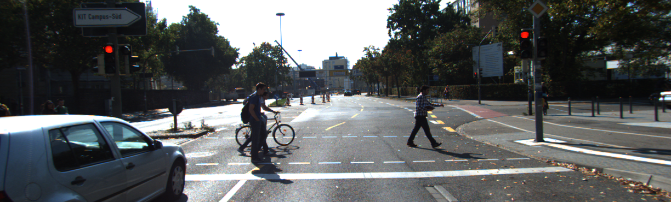
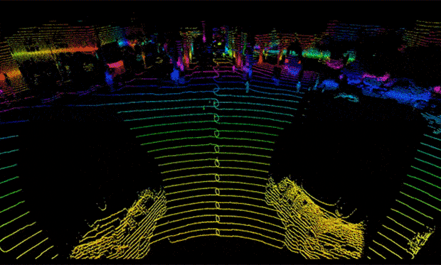
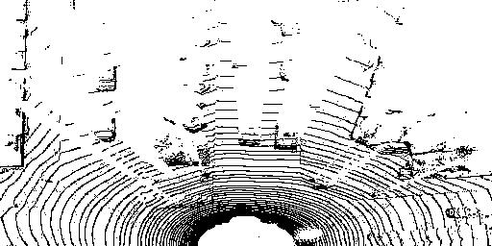
Research Gaps
Sensor Modalities:
Camera: 2D image.
LiDAR: 3D point cloud and 2D BEV image.
Use of multi-sensor data might be beneficial for object detection.
Research Gaps
Notes:
Better visibility of occluded objects (depends on mounting of LIDAR).
Using multi-sensor data, we can provide more information to the model.

Slide 10
Research Gaps
Multi sensor modality: data fusion.
Late Fusion for e.g., CLOCs⁷. Little exchange of information.
Slow Fusion: for e.g., AVOD⁸. Dependency on good calibration.
Deep and Slow Fusion: for e.g., TransFuser.
Research Gap: TransFuser doesn‘t solve object detection task.
Su Pang et al. “CLOCs:Camera-LiDAR object Candidates fusion for 3D object detection” (IROS), 2020.
Jason Ku et al. “Joint 3d proposal generation and object detection from view aggregation” (IROS), 2018.
Research Gaps
Notes:
Using multi-sensor data, we can provide more information to the model.
Late Fusion: each modality is processed seperately and fusion takes place in last step.
In slow fusion, fusion takes place at multiple places throughout the model, by geometric means or by some algorithm.
Deep and slow fusion - fusion by neural network at multiple steps

Slide 11
Research Gaps
Object Detection Approaches:
Conventional Approaches: One and Two stage object detection models (for e.g., YOLO⁵, Faster-RCNN⁶).
Drawbacks: Prior knowledge, Post-processing steps.
Recent Approaches: direct set prediction task (for e.g., DeTr).
Advantage: direct predictions.
Research Gap: DeTr doesn‘t use multi-sensor data.
R.Joseph “You only look once: Unified, real-time object detection” (CVPR) 2016.
S.Ren et al. “Faster R-CNN: Towards real-time object detection with region proposal networks” (NeurIPS), 2015.
Research Gaps
Notes:
Advantages od Conventional approaches - laid foundation of object detection and good performance.
Need of prior knowledge for example, empirical anchor boxes, RPN networks and grid sizes.
Post processing steps, for filtering out duplicate predictions such as NMS, which is hand-crafted and greedy approach.
NMS is threshold-based and requires an IOU (intersection over union) and confidence threshold tuning to be able to effectively discard the overlapping bounding boxes.
Object detection – predicting the set of objects in an image – is an example of a set prediction problem.
Properties of a set –
The size of the set is not fixed. A set can has 0 or N data.
The order of the set is not fixed.
Object detection is set prediction problem i.e., predict the cardinality of the set and then predict the labels for each element. Also predict the bbox coordinates for each element of the set.
Set prediction detection examples: DeepSetNet, TSP-FCOS (Transformer-based Set Prediction with Fully Convolutional One-Stage object detector) and TSP-RCNN (Transformer-based Set Prediction with RCNN).

Slide 12
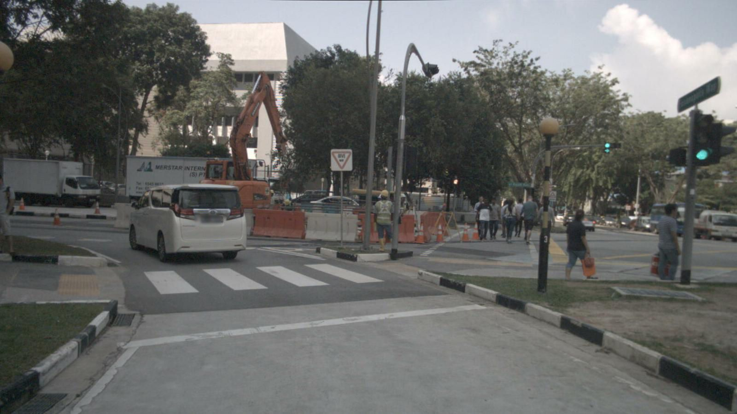
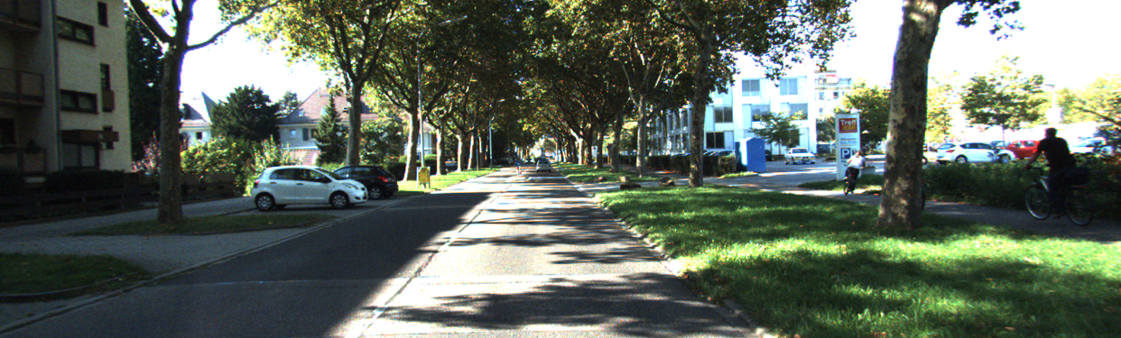
Research Gaps
Extension of DeTr and TransFuser model.
TransFuserDeTr: TransFuser + DeTr model.
Evaluation on Kitti dataset (7.4K images).
Pre-training on NuScenes⁴ dataset (34K images).
C.Holger et al. “Nuscenes: A multimodal dataset for autonomous driving” (CVPR), 2020.
Research Gaps

Slide 13
Outline
Motivation
Related Work
Research Gaps
Methodology
Experiments
Qualitative Results
Conclusion and Future Work
References

Slide 14
Baseline DeTr Model
Training DeTr on Kitti dataset for object detection task.
Kitti to COCO¹² data format conversion.
Baseline set up: code migration.
Evaluation on Kitti dataset (7481 images).
Prediction selection using threshold value (during evaluation).
Transfer Learning from COCO to Kitti dataset for DeTr model.
Different experimental set up to find the best setting.
Tsung-Yi.Lin et al. “Microsoft COCO: Common objects in context” (ECCV), 2014.
Methodology
Notes:
Making code more readable by decoupling the research code from the engineering
Automating most of the training loop
Removing boilerplates (sections of code that have to be included in many places with little or no alteration)
Integration with popular logging/visualizing frameworks such as Tensorboard, MLFlow, Neptune.ai.
PyTorch Lightning has minimal running speed overhead (about 300 ms per epoch compared with PyTorch).
Computing metrics such as accuracy, precision, recall etc. across multiple GPUs.
Automating optimization process of training models.
Logging.
Checkpointing.

Slide 15
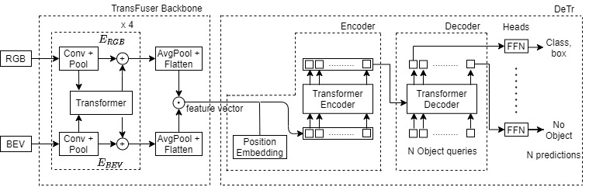
TransFuserDeTr Model
Replace DeTr backbone by TransFuser.
TransFuser and DeTr customisations.
BEV generation.
Methodology
Notes:
Explain functioning of model.
TransFuser customisations:
only camera front view and corresponding BEV were used while original used multi-views image sequence along with velocity vector.
Input image size is (512, 1024) instead of (256,256) input image.
In Transformer use only encoder-decoder layers -2, number of attention head - 1, linear layer dim in Feed forward network in Transformer called block_exp – 1, instead of (6,8,4).
Use concatenation operator instead of element wise summation +.
DeTr customisations:
Input to DeTr model was also change to multi-sensor data.
DeTr’s Dataset and DataLoader were modified to load Kitti RGB and BEV data.
Image size – (1024, 512)
Feature map size – input to detr - ([1, 2048, 36, 24])

Slide 16
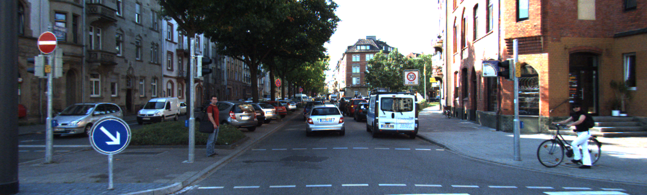
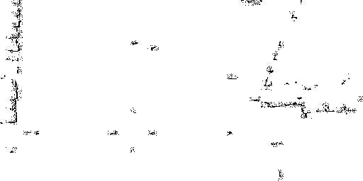
TransFuserDeTr Model: BEV Generation
2 channel BEV capturing the camera view.
Methodology
Notes:
Forward range – (0, 40)
Side range – (-20, 20)
Channel 0 – height (-5, 0)
Channel 1 – height (0 to 5)

Slide 17
TransFuserDeTr Model
Replace DeTr backbone by TransFuser.
TransFuser and DeTr customisations.
BEV generation.
Find the best experimental set up.
Methodology
Notes:
Explain functioning of model.
TransFuser customisations:
only camera front view and corresponding BEV were used while original used multi-views image sequence along with velocity vector.
Input image size is (512, 1024) instead of (256,256) input image.
In Transformer use only encoder-decoder layers -2, number of attention head - 1, linear layer dim in Feed forward network in Transformer called block_exp – 1, instead of (6,8,4).
Use concatenation operator instead of element wise summation +.
DeTr customisations:
Input to DeTr model was also change to multi-sensor data.
DeTr’s Dataset and DataLoader were modified to load Kitti RGB and BEV data.

Slide 18
Kitti Dataset: Different Splits
TransFuserDeTr performance testing on different data splits:
Split 1
Split 2¹³
Split 3
C.Xiaozhi et al. “3d object proposals for accurate object class detection” (NeurIPS), 2015.
Methodology
Notes:
Explain functioning of model.
TransFuser customisations:
only camera front view and corresponding BEV were used while original used multi-views image sequence along with velocity vector.
Input image size is (512, 1024) instead of (256,256) input image.
In Transformer use only encoder-decoder layers -2, number of attention head - 1, linear layer dim in Feed forward network in Transformer called block_exp – 1, instead of (6,8,4).
Use concatenation operator instead of element wise summation +.
DeTr customisations:
Input to DeTr model was also change to multi-sensor data.
DeTr’s Dataset and DataLoader were modified to load Kitti RGB and BEV data.

Slide 19
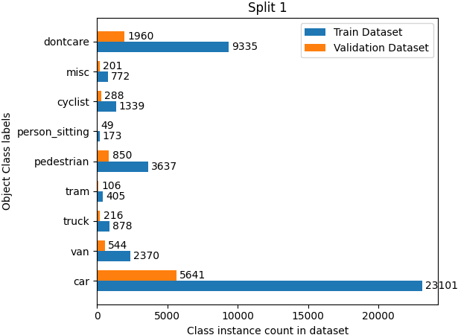
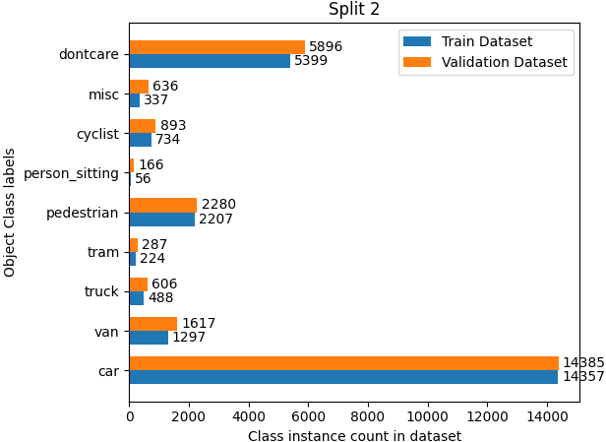
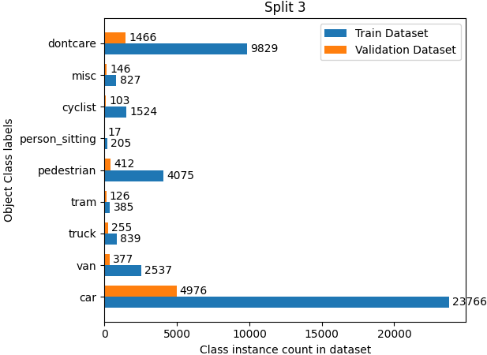
Kitti Dataset: Different Splits
Split 1
80:20 (Ours) (used so far)
No image sequence.
Split 2
50:50 (less training data)
Considers image sequence.
Split 3
80:20 (Ours) (used further)
Considers image sequence.
Methodology
Notes:
7481 images
Analysis:
Maximum count of: Cars
Second count of: Pedestrians
Least count of: Cyclist
Split 1 can not be used further because of drawback.
Split 2 has less training data
Split 3 has more training data
Split 3 is created by using every 5th sequence as the validation sequence and rest as training sequences.

Slide 20
Transfer Learning using NuScenes
Overfitting challenge on split 3.
Training on bigger dataset
Possible Solutions: L1, L2 Reg., Weight decay, Auxiliary Loss, Dropout, Data Augmentation (not effective)
Model pre-training
Pre-training on NuScenes dataset (34k images).
Fine tuning on Kitti dataset (split 3).
Evaluation using Kitti evaluator on both datasets.
Methodology
Notes:
Many solutions of overfitting are:
Regularization (L2 and L2+L1)
Weight Decay (AdamW already has weight decay)
Auxiliary Losses (already used)
Dropout (10% already present)
Reduce model capacity (already too few parameters, can’t reduce further)
Data Augmentation
Data Normalisation
Early stopping (no effect)
Simplify model (can simplify more than this)
DFKI internal library DTK was used for Data Loading with some customizations (basically filtering the annotations and dataset length).
For this research, used object annotations with less than 50% occlusion.
NuScenes has total 23 object classes, only 18 were used in annotations.
18 classes were further mapped to only 6 classes i.e., car, bus, truck, cyclist, pedestrian and dontcare.
Only front and back camera data is used, for this research.
NuScenes annotations are present in 3D which are converted to 2D annotations by DFKI internal library.
kitti dataset uses average precision (AP) metric. Inter- section over Union (IoU) is used to measure the overlapping between predicted and ground truth bounding box. Overlap should be more than 50% for True Positive (TP). False Positive (FP) corresponds to multiple detection for the same ground truth object.
NuScenes calculates AP by finding 2D distance between the centre of predictions and ground truth bounding boxes. Then, classify them as TP and FP for different threshold distance (0.5, 1, 2, 4, in meters) values and take mean over all classes.
It is better way to find AP for NuS because images has lots of small sized annotations, thus can not rely much on Kitti evaluation results.

Slide 21
Outline
Motivation
Related Work
Research Gaps
Methodology
Experiments
Qualitative Results
Conclusion and Future Work
References

Slide 22
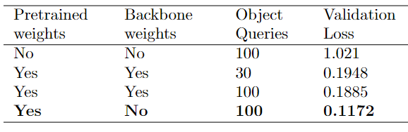
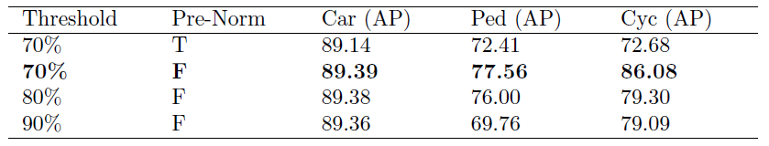
Baseline DeTr Model
Using Kitti dataset (split 1).
DeTr pretrained weights versus scratch training.
Hyper-parameter tuning
Experiments
Notes:
Highlighted experiments (bold ones) in both tables are same.
Threshold values below 70% doesn‘t improve performance.
The whole model is trained with 10^-4 and backbone is trained with 10^-5 learning rate.
Use DeTr pretrained weights, training is not possible without it.
Query objects weights is important, training is not possible without it.
Not using Backbone weights is beneficial.
Medium level difficulty for Kitti AP values.

Slide 23
TransFuserDeTr Model
Using Kitti dataset (split 1).
Experiments
Notes:
ip pw: input_proj layer pretrained weights, Hyper Params include (#head, #layers, block_exp, step size), Image and LIDAR Encoder, DA: Data Augmentation, PG: Parameter Grouping, Car, Ped: Pedestrian, Cyc: Cyclist shows Average Precision (AP₇₀ in %) medium difficulty value, R18: ResNet18, R34: ResNet34, R50: ResNet50, Y: Yes, N:No, M: Million, + referes element-wise summation, (.)referes concatenation, * referes 1x1 convolution layer is used and ‘ referes pretrained weights are used.

Slide 24
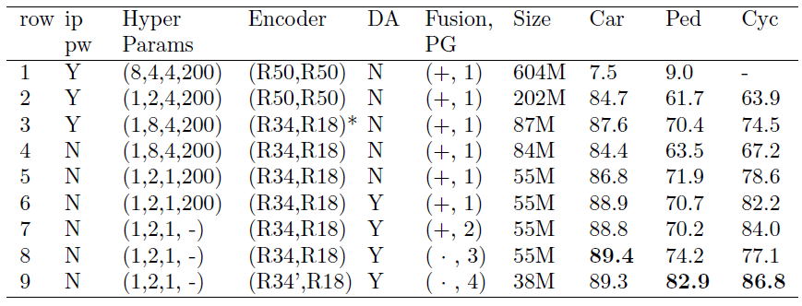
TransFuserDeTr Model
Using Kitti dataset (split 1).
Pretrained weights for RGB and BEV Image Encoder (Row 1).
TransFuser Backbone hyper parameter tuning (Row 2).
TransFuser RGB and BEV image Encoder (Row 3).
Experiments
Notes:
ip pw: input_proj layer pretrained weights, Hyper Params include (#head, #layers, block_exp, step size), Image and LIDAR Encoder, DA: Data Augmentation, PG: Parameter Grouping, Car, Ped: Pedestrian, Cyc: Cyclist shows Average Precision (AP₇₀ in %) medium difficulty value, R18: ResNet18, R34: ResNet34, R50: ResNet50, Y: Yes, N:No, M: Million, + referes element-wise summation, (.)referes concatenation, * referes 1x1 convolution layer is used and ‘ referes pretrained weights are used.
Tried R34 in BEV and R18 in RGB Encoder, earlier kept the performance same or very little bit better but for later case it was worse than current performance.

Slide 25
TransFuserDeTr Model
Using Kitti dataset (split 1).
Weight Initialisation techniques (no significant improvement).
TransFuserDeTr Model optimisation (Row 4 and 5).
Data Augmentation (Row 6, also reduced generalisation gap).
Experiments
Notes:
1. Normal Weight Initialization: technique initializes weights by values sampled from normal distribution (mean=0 and standard deviation (σ)= 1).
2. He Normal Weight Initialization: or kaiming Normal : technique samples initial weights from normal distribution with mean=0 and standard deviation: (σ =√ 2/fan_mode ), where fan mode is length of weight tensor.
3. Orthogonal Weight Initialization: technique sample initial weights from a orthogonal matrix.
DA: RandomHorizontal Flip, RandomCrop, RandomSelect, ColorJittering, RandomGrayscale, ToTensor, Normalise.
ip pw: input_proj layer pretrained weights, Hyper Params include (#head, #layers, block_exp, step size), Image and LIDAR Encoder, DA: Data Augmentation, PG: Parameter Grouping, Car, Ped: Pedestrian, Cyc: Cyclist shows Average Precision (AP₇₀ in %) medium difficulty value, R18: ResNet18, R34: ResNet34, R50: ResNet50, Y: Yes, N:No, M: Million, + referes element-wise summation, (.)referes concatenation, * referes 1x1 convolution layer is used and ‘ referes pretrained weights are used.

Slide 26
TransFuserDeTr Model
Using Kitti dataset (split 1).
Feature fusion technique & different parameter groupings (Row 7, 8, 9).
Miscellaneous Experiments: different image resolution, LR Scheduler, lr, normalize BEV, position encoding etc (no improvement).
Experiments
Notes:
Different image resolution: (512, 1024) or (384, 1280)
Position encoding – sine/learned
Lr scheduler – exponential and SWALR
Lr – 10-3, 10-4, 10-5
Differnt weight decay factor- 10-3, 10-4, 10-5
Different parameter grouping lr rates- 10-3, 10-4, 10-5
Whether to pass squared BEV image or normal BEV image.
Normalise BEV or not – histogram genration on the basis of number of lidar points. Normalize by maximum number of points in any histogram bar.
ip pw: input_proj layer pretrained weights, Hyper Params include (#head, #layers, block_exp, step size), Image and LIDAR Encoder, DA: Data Augmentation, PG: Parameter Grouping, Car, Ped: Pedestrian, Cyc: Cyclist shows Average Precision (AP₇₀ in %) medium difficulty value, R18: ResNet18, R34: ResNet34, R50: ResNet50, Y: Yes, N:No, M: Million, + referes element-wise summation, (.)referes concatenation, * referes 1x1 convolution layer is used and ‘ referes pretrained weights are used.

Slide 27
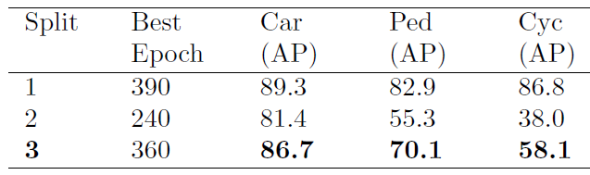
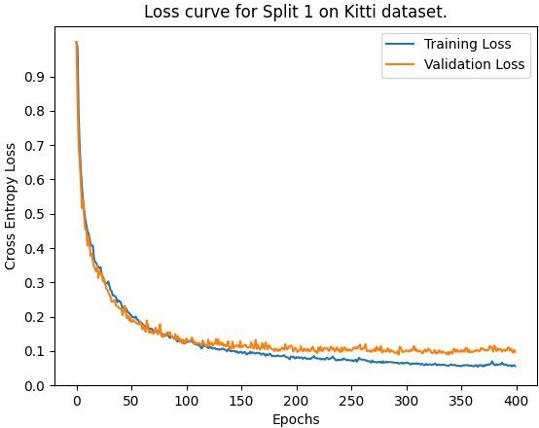
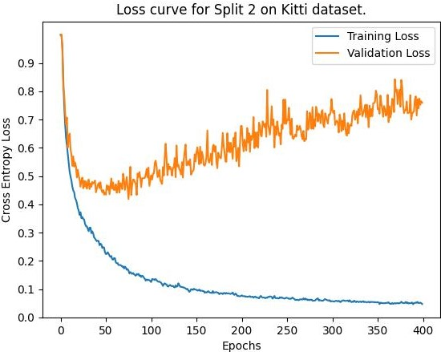
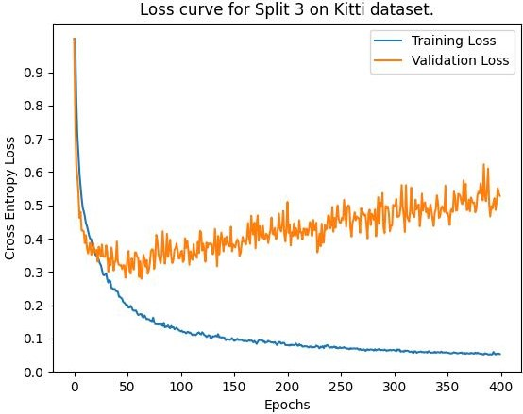
TransFuserDeTr Model: Different Splits
Model evaluation for split 1, 2 and 3.
More training data in split 3 than 2: Less overfitting.
Car enough training data: AP₇₀ is not affected much among three splits.
Ped & Cyc less training data: least AP₇₀ & varies between split 2 and 3.
Experiments
Notes:
Compared to split 2, AP₇₀ values for split 3 are higher by 5.3, 14.8 and 20.1 values for car, pedestrian and cyclist, respectively.
Compared to other objects, Cyclist instance count in dataset is very less, this might be the reason for Cyclist to have least AP70 value i.e., 58.1 among all other classes.
Car has lot of data thus not much difference in the AP values for Car object.
For Split 2 and split 3 - L1 and GIoU loss both also have generalization gap.
Split 1 – 175 exp – 38M – PG 4 – row 9th setting
Split 2 – 168 exp – 38 M - PG 4 – row 9th setting
Split 3 – 139 exp – 38 M - PG 4 – row 9th setting

Slide 28
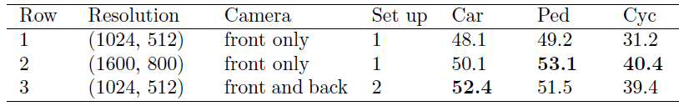
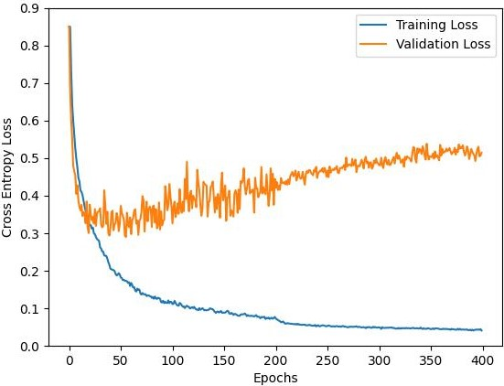
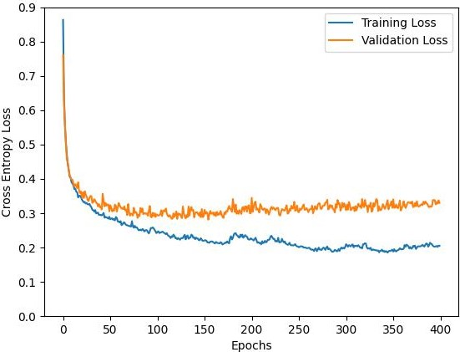
Transfer Learning using NuScenes
TransFuserDeTr model evaluation on NuScenes dataset using Kitti evaluator.
Kitti (split 3) versus NuScenes Classification Loss.
Experiments
Notes:
Table 1:
High resolution has better performance.
More data has better performance.
Graph 1:
Advantage: NuScenes doesn’t has any overfitting problem – might be because of more training data
Advantage: NuScenes has less generalization gap compared to kitti dataset - might be because of more training data
Drawback: NuScenes classification loss converges at higher value than Kitti – model is not learning generalized features.
L1 and GIoU loss both also have generalization gap.
Kitti loss curve is for experiment – TransFuserDeTr using pre-trained weights – exp 224 (270 epoch – can be stopped after it) – shown in SOTA table with name TransFuserDeTr (w) [Ours] method.
NuScenes calculates AP by finding 2D distance between the centre of predictions and ground truth bounding boxes. Then, classify them as TP and FP for different threshold distance (0.5, 1, 2, 4, in meters) values and take mean over all classes.
It is better way to find AP for NuS because images has lots of small sized annotations, thus can not rely much on Kitti evaluation results.
kitti dataset uses average precision (AP) metric. Inter- section over Union (IoU) is used to measure the overlapping between predicted and ground truth bounding box. Overlap should be more than 50% for True Positive (TP). False Positive (FP) corresponds to multiple detection for the same ground truth object.
Setup 1: Same as used for experiment in phase 2 Table1 (big table) 9th Row.
Setup 2: Same as used for experiment in phase 2 Table1 (big table) 8th Row. The only difference is ImageNet pretrained weights were used for ResNet34.

Slide 29
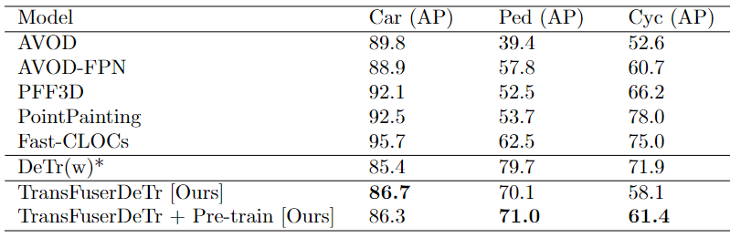
SOTA Comparison
Comparison between TransFuserDeTr model and SOTA on Kitti dataset.
For Pedestrian: TransFuserDeTr outperforms all SOTA (except DeTr).
For Car: TransFuserDeTr outperforms DeTr.
For Cyclist: TransFuserDeTr outperforms AVOD and AVOD-FPN.
Pretraining TransFuserDeTr on NuScenes, improved AP₇₀ for Pedestrian and Cyclist classes.
[8]
[8]
[9]
[10]
[11]
Experiments
Notes:
* denotes the results of DeTr² on Kitti dataset were not published by Carion et al. but calculated in this research. SOTA models represents results on Kitti test benchmark. (w) and (w/o) represents TransFuserDeTr model trained with and without NuScenes pretrained weights, respectively.
DeTr (with backbone pretrained weights) – sheet 1, 64 exp
TFDT (without pretraining) – 139 exp – set up same as the split 1,2,3 table – set up 1 - 38M params – PG 4 – row 9th setting
TFDT (with pretraining on NuS) – 224 exp – with weights of 3rd row of NuScenes training table – set up 2 - 55M params – PG 3 – 8th row setting.

Slide 30
Outline
Motivation
Related Work
Research Gaps
Methodology
Experiments
Qualitative Results
Conclusion and Future Work
References

Slide 31
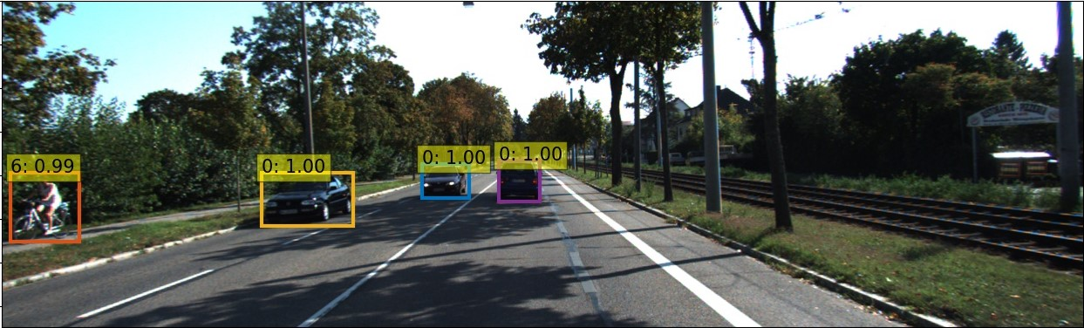
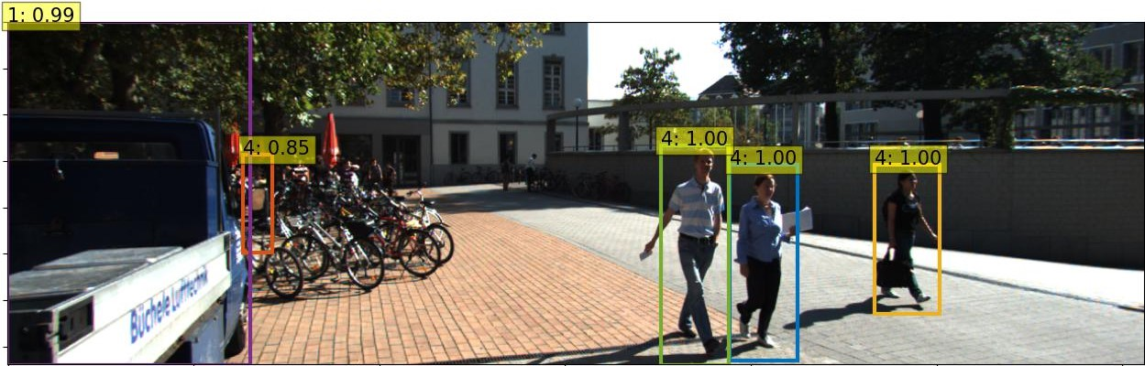
Qualitative Results
TransFuserDeTr model prediction visualisation on Kitti dataset (split 3).
Qualitative Results

Slide 32
Outline
Motivation
Related Work
Research Gaps
Methodology
Experiments
Qualitative Results
Conclusion and Future Work
References

Slide 33
Conclusion
Transfer Learning on DeTr from COCO to Kitti dataset.
Novel architecture TransFuserDeTr successfully performs end-to-end object detection task using mulit-sensor data.
Do not need any calibration between sensor data.
More training data: better model performance (AP value) and lower the loss, overfitting, generalisation gap challenges.
Pre-training TransFuserDeTr enhances performance for Pedestrian and Cyclist, though couldn‘t address overfitting.
TransFuserDeTr performs better than DeTr for Car prediction.
TransFuserDeTr performs better than other SOTA using multi-sensor data, for Pedestrian (except DeTr) and Cyclist (AVOD, AVOD-FPN).
Conclusion
Notes:
Point 4 – loss curve of split 2 and 3, loss curve of NuScenes training.

Slide 34
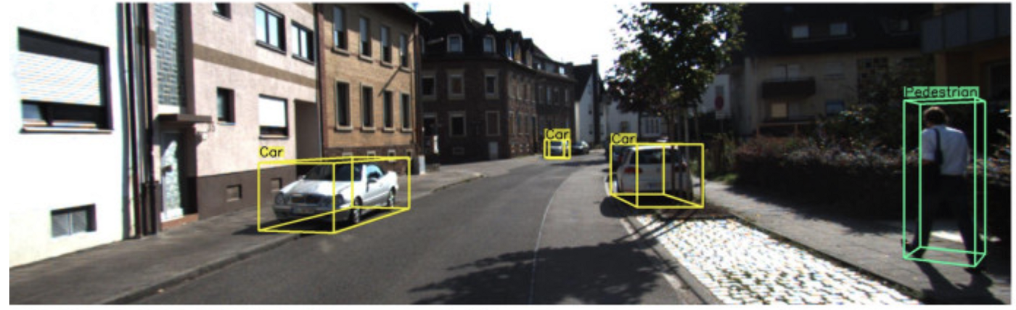
Future Work
Use TransFuserDeTr model for 3D Object Detection task.
Future Work
Notes:
Model has depth knowledge.
Foundation for using 3D annotated dataset i.e., Kitti and NuScenes is already laid.
TransFuserDeTr model’s prediction heads investigation.

Slide 35
References
Aditya Prakash, Kashyap Chitta, and Andreas Geiger. “Multimodal fusion transformer for end-to-end autonomous driving”. In: IEEE Conference on Computer Vision and Pattern Recognition (CVPR). 2021
Nicolas Carion, Francisco Massa, Gabriel Synnaeve, and N.Usunier et al. “End-to-end object detection with transformers”. In: European Conference on Computer Vision (ECCV). Springer. 2020.
Andreas Geiger, Philip Lenz, Christoph Stiller, and Raquel Urtasun. “Vision meets robotics: The kitti dataset”. In: The International Journal of Robotics Research (IJRR) 32.11 (2013), pp. 1231–1237.
Holger Caesar, Varun Bankiti, Alex H Lang, and S.Vora et al. “Nuscenes: A multimodal dataset for autonomous driving”. In: IEEE Conference on Computer Vision and Pattern Recognition (CVPR). 2020.
Joseph Redmon, Santosh Divvala, Ross Girshick, and Ali Farhadi. “You only look once: Unified, real-time object detection”. In: IEEE Conference on Computer Vision and Pattern Recognition (CVPR) 2016.
Shaoqing Ren, Kaiming He, Ross Girshick, and Jian Sun. “Faster R-CNN: Towards real-time object detection with region proposal networks”. In: Advances in Neural Information Processing Systems (NeurIPS) 28 (2015).
Su Pang, Daniel Morris, and Hayder Radha. “CLOCs: Camera-LiDAR object candidates fusion for 3D object detection”. In: IEEE/RSJ International Conference on Intelligent Robots and Systems (IROS). IEEE. 2020.
Jason Ku, Melissa Mozifian, Jungwook Lee, and A.Harakeh et al. “Joint 3d proposal generation and object detection from view aggregation”. In: IEEE/RSJ International Conference on Intelligent Robots and Systems (IROS). 2018.
Li-Hua Wen and Kang-Hyun Jo. “Fast and accurate 3D object detection for lidar-camera-based autonomous vehicles using one shared voxel-based backbone”. In: IEEE Access 9 (2021), pp. 22080–22089.
Sourabh Vora, Alex H Lang, Bassam Helou, and Oscar Beijbom. “Pointpainting: Sequential fusion for 3d object detection”. In: IEEE Conference on Computer Vision and Pattern Recognition (CVPR). 2020.
References

Slide 36
References
Su Pang, Daniel Morris, and Hayder Radha. “Fast-CLOCs: Fast Camera-LiDAR Object Candidates Fusion for 3D Object Detection”. In: Proceedings of the IEEE/CVF Winter Conference on Applications of Computer Vision. 2022.
Tsung-Yi Lin, Michael Maire, Serge Belongie, and J.Hays et al. “Microsoft COCO: Common objects in context”. In: European Conference on Computer Vision (ECCV). Springer. 2014.
Xiaozhi Chen, Kaustav Kundu, Yukun Zhu, and A.G.Berneshawi et al. “3d object proposals for accurate object class detection”. In: Advances in Neural Information Processing Systems (NeurIPS) 28 (2015).
Ashish Vaswani, Noam Shazeer, Niki Parmar, and J.Uszkoreit et al. “Attention is all you need”. In: Advances in Neural Information Processing Systems (NeurIPS) 30 (2017).
References
Notes:
Joseph Redmon, Santosh Divvala, Ross Girshick, and Ali Farhadi. “You only look once: Unified, real-time object detection”. In: IEEE Conference on Computer Vision and pattern Recognition (CVPR). 2016.

Slide 37
Thank You
Happy Researching ☺

Slide 38
Analytical DeTr
Self-attention mechanisms explicitly model all pairwise interactions between elements in a sequence, make DeTr suitable for specific constraints of set prediction such as removing duplicate predictions.
Bipartite matching between ground-truth and prediction enforces permutation-invariance and guarantees that each target element has a unique match.
Transformer architecture is permutation-invariant, fixed positional encodings are added to the input of each attention layer.
Using self- and encoder-decoder attention, the model globally reasons about all objects together, by using pair-wise relations between them, while being able to use the whole image as context.
“background" class.
R.Stewart et al. “End-to-end people detection in crowded scenes” (CVPR) 2016.
Related Work
Notes:
Cost matrix losses are pair-wise losses.
Cost matrix L1 loss – cdist loss - Computes batched the p-norm distance between each pair of the two collections of row vectors.
Similary pair-wise GIoU loss - Returns a [N, M] pairwise matrix, where N = len(boxes1) and M = len(boxes2)

Slide 39
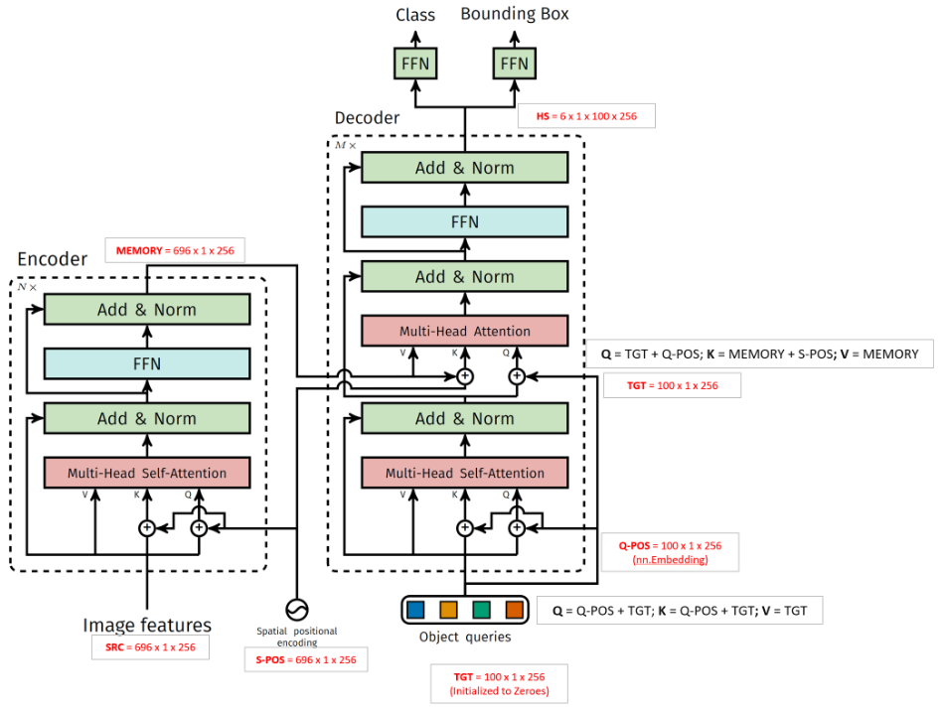
DETR Annotation
Related Work
Notes:
Linear sum assignment algorithm

Slide 40
DETR Loss
Firstly, matching between the predicted and ground truth is done by using bipartite matching.
Cost matrix include pair-wise matching cost of classification loss and bbox similarity (L1 loss and GIoU loss).
Once cost matrix is available, apply bipartite matching to find mini cost assignment between ground truth and predictions.
As per matching extend target table to N (object queries size) size.
Then, perform object specific loss i.e. CE loss for classification and (L1 and GIoU loss for bbox coord regression).
R.Stewart et al. “End-to-end people detection in crowded scenes” (CVPR) 2016.
Related Work
Notes:
Cost matrix losses are pair-wise losses.
Cost matrix L1 loss – cdist loss - Computes batched the p-norm distance between each pair of the two collections of row vectors.
Similary pair-wise GIoU loss - Returns a [N, M] pairwise matrix, where N = len(boxes1) and M = len(boxes2)

Slide 41
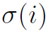
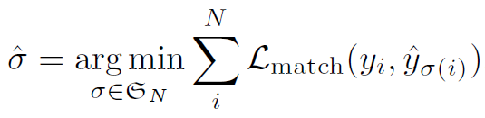
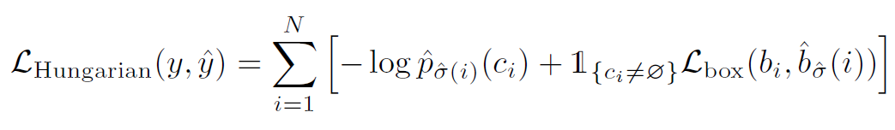
DETR Loss
Optimal bipartite matching(one-to-one) between ground truth (y) and set of N predicted objects
L(match) is a pair-wise matching cost (class prediction and similarity of predicted and ground truth bbox) between y{i} and a prediction with index
Object specific loss – for all matched pairs. Linear combination of class prediction (CE) and bbox loss (L1, GIoU).
R.Stewart et al. “End-to-end people detection in crowded scenes” (CVPR) 2016.
Related Work
Notes:
Joseph Redmon, Santosh Divvala, Ross Girshick, and Ali Farhadi. “You only look once: Unified, real-time object detection”. In: IEEE Conference on Computer Vision and pattern Recognition (CVPR). 2016.

Slide 42
Bipartite Matching
Find the mini of each row and subtract from each row.
Find the mini of each column and subtract from each column.
Find mini number of vertical or horizontal lines that are needed to cover all zeros in the table (if equal to number of rows, reached optimum).
Find mini from uncovered values of matrix and subtract that mini value from all the uncovered values and add mini value to all the cells where lines are intersecting (corner points).
Repeat the step until number of lines needed to cover all zeros are equal to number of rows in cost table.
Related Work
Notes:
Linear sum assignment algorithm

Slide 43
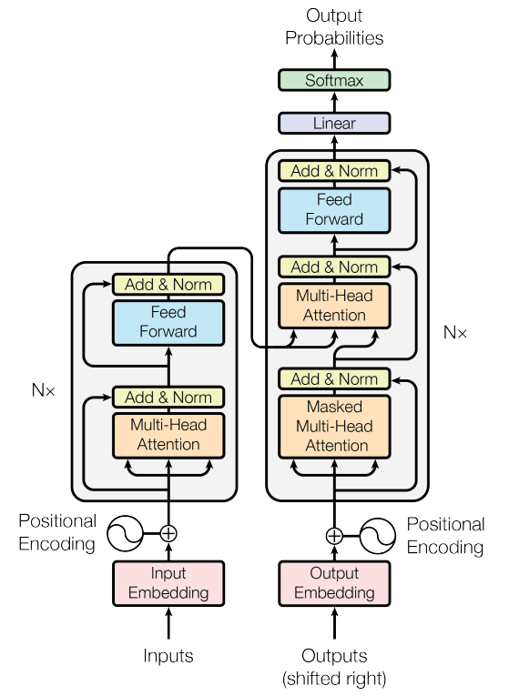
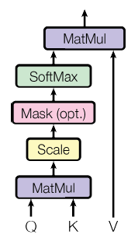
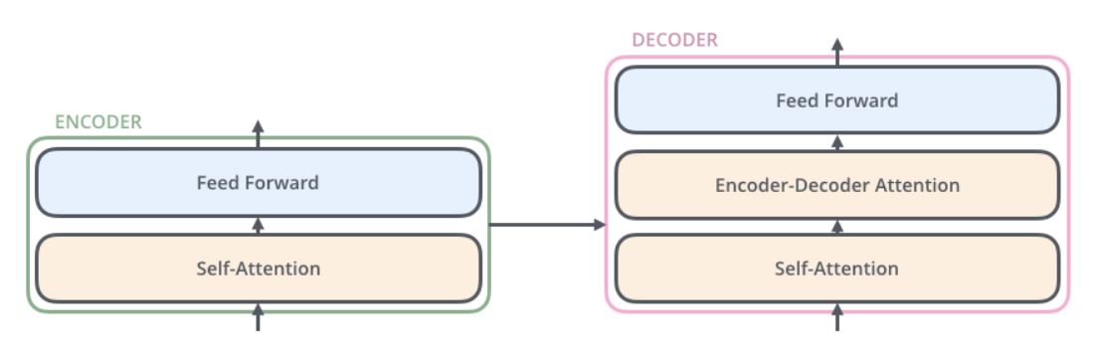
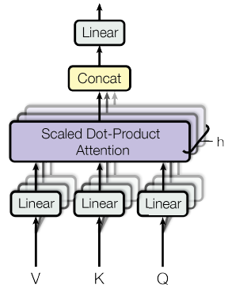
Related Work: Transformer
Related Work
Notes:
The encoder’s inputs first flow through a self-attention layer – a layer that helps the encoder look at other words in the input sentence as it encodes a specific word.
The animal didn't cross the street because it was too tired”.
The size of embedding layer is hyperparameter – basically it would be the length of the longest sentence in our training dataset.
Sentence: Thinking Machines.
Self-attention:
step 0- apply embedding on input word.
step 1- calculate Query, Key, Value vector – by multiplying the embedding by three matrices that we trained during the training process.
step 2- calculate self-attention is to calculate a score. The score determines how much focus to place on other parts of the input sentence as we encode a word at a certain position. Say we’re calculating the self-attention for the first word in this example, “Thinking”. We need to score each word of the input sentence against this word.
Score calculation: The score is calculated by taking the dot product of the query vector with the key vector of the respective word we’re scoring.
So if we’re processing the self-attention for the word in position #1, the first score would be the dot product of q1 and k1. The second score would be the dot product of q1 and k2.

Slide 44
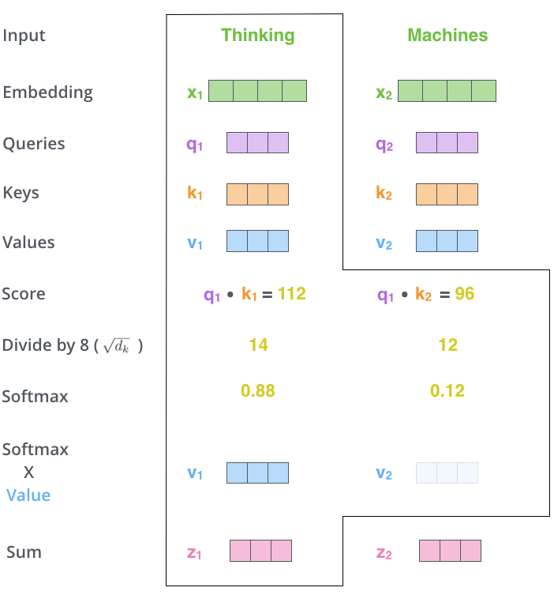
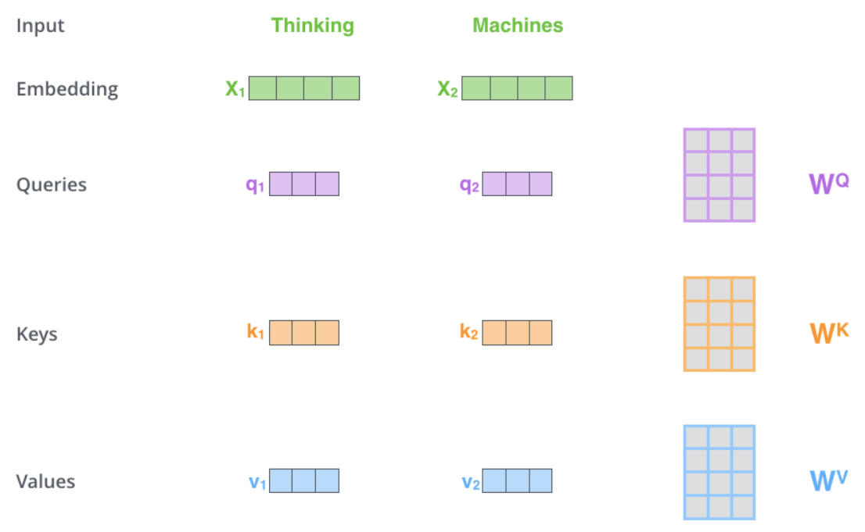
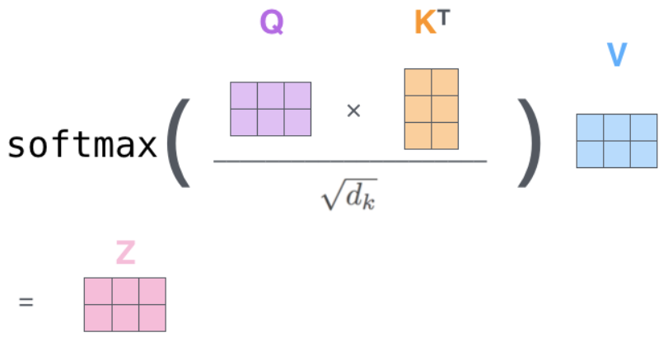
Attention Mechanism
Related Work
Notes:
The encoder’s inputs first flow through a self-attention layer – a layer that helps the encoder look at other words in the input sentence as it encodes a specific word.
The animal didn't cross the street because it was too tired”.
The size of embedding layer is hyperparameter – basically it would be the length of the longest sentence in our training dataset.
Sentence: Thinking Machines.
Self-attention:
step 0- apply embedding on input word.
step 1- calculate Query, Key, Value vector – by multiplying the embedding by three matrices that we trained during the training process.
step 2- calculate self-attention is to calculate a score. The score determines how much focus to place on other parts of the input sentence as we encode a word at a certain position. Say we’re calculating the self-attention for the first word in this example, “Thinking”. We need to score each word of the input sentence against this word.
Score calculation: The score is calculated by taking the dot product of the query vector with the key vector of the respective word we’re scoring.
So if we’re processing the self-attention for the word in position #1, the first score would be the dot product of q1 and k1. The second score would be the dot product of q1 and k2.
Step 4- divide the scores by 8 (the square root of the dimension of the key vectors used in the paper – 64. This leads to having more stable gradients.
Step 5- then pass the result through a softmax operation. Softmax normalizes the scores so they’re all positive and add up to 1.
Step 6- multiply each value vector by the softmax score (in preparation to sum them up). The intuition here is to keep intact the values of the word(s) we want to focus on, and drown-out irrelevant words.
Step 7- sum up the weighted value vectors. This produces the output of the self-attention layer at this position (for the first word).

Slide 45
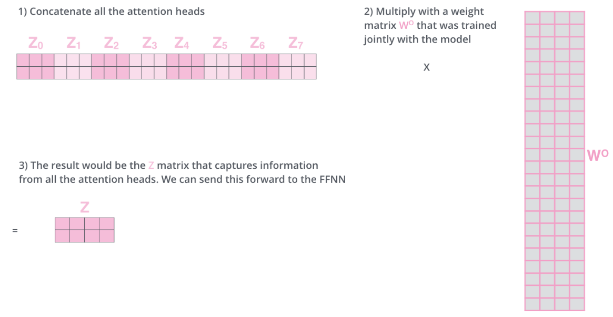
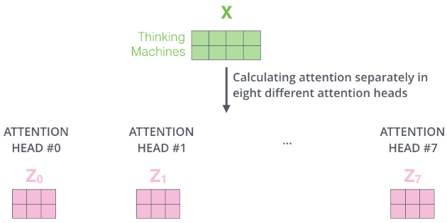
Multi Head - Attention Mechanism
Related Work
Notes:
The encoder’s inputs first flow through a self-attention layer – a layer that helps the encoder look at other words in the input sentence as it encodes a specific word.
The animal didn't cross the street because it was too tired”.
The size of embedding layer is hyperparameter – basically it would be the length of the longest sentence in our training dataset.
Sentence: Thinking Machines.
Self-attention:
step 0- apply embedding on input word.
step 1- calculate Query, Key, Value vector – by multiplying the embedding by three matrices that we trained during the training process.
step 2- calculate self-attention is to calculate a score. The score determines how much focus to place on other parts of the input sentence as we encode a word at a certain position. Say we’re calculating the self-attention for the first word in this example, “Thinking”. We need to score each word of the input sentence against this word.
Score calculation: The score is calculated by taking the dot product of the query vector with the key vector of the respective word we’re scoring.
So if we’re processing the self-attention for the word in position #1, the first score would be the dot product of q1 and k1. The second score would be the dot product of q1 and k2.
Step 4- divide the scores by 8 (the square root of the dimension of the key vectors used in the paper – 64. This leads to having more stable gradients.
Step 5- then pass the result through a softmax operation. Softmax normalizes the scores so they’re all positive and add up to 1.
Step 6- multiply each value vector by the softmax score (in preparation to sum them up). The intuition here is to keep intact the values of the word(s) we want to focus on, and drown-out irrelevant words.
Step 7- sum up the weighted value vectors. This produces the output of the self-attention layer at this position (for the first word).

Slide 46
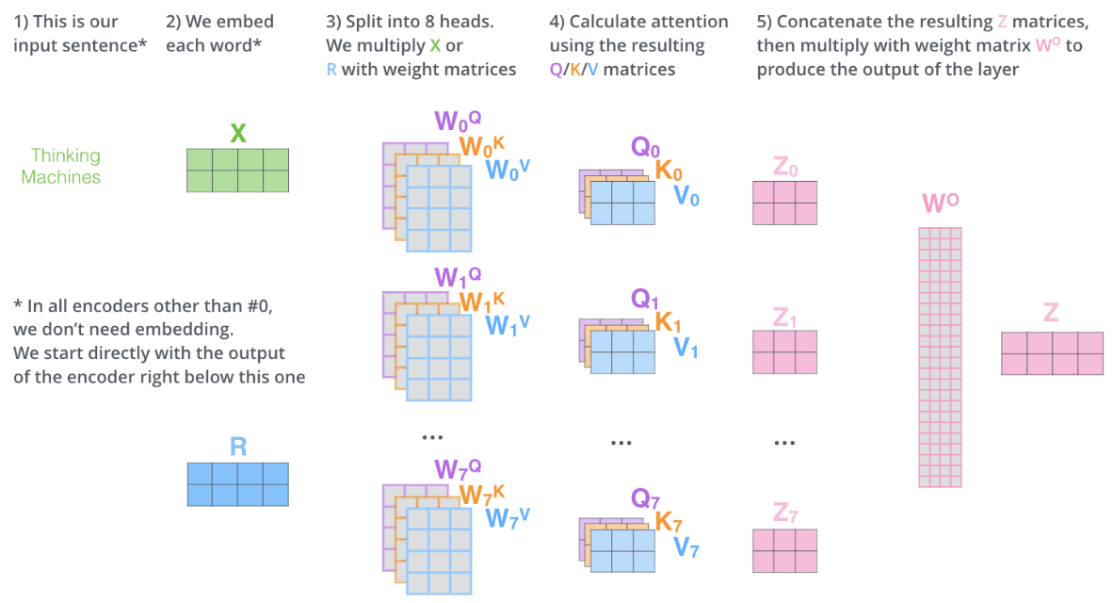
Multi Head - Attention Mechanism
Related Work
Notes:
The encoder’s inputs first flow through a self-attention layer – a layer that helps the encoder look at other words in the input sentence as it encodes a specific word.
The animal didn't cross the street because it was too tired”.
The size of embedding layer is hyperparameter – basically it would be the length of the longest sentence in our training dataset.
Sentence: Thinking Machines.
Self-attention:
step 0- apply embedding on input word.
step 1- calculate Query, Key, Value vector – by multiplying the embedding by three matrices that we trained during the training process.
step 2- calculate self-attention is to calculate a score. The score determines how much focus to place on other parts of the input sentence as we encode a word at a certain position. Say we’re calculating the self-attention for the first word in this example, “Thinking”. We need to score each word of the input sentence against this word.
Score calculation: The score is calculated by taking the dot product of the query vector with the key vector of the respective word we’re scoring.
So if we’re processing the self-attention for the word in position #1, the first score would be the dot product of q1 and k1. The second score would be the dot product of q1 and k2.
Step 4- divide the scores by 8 (the square root of the dimension of the key vectors used in the paper – 64. This leads to having more stable gradients.
Step 5- then pass the result through a softmax operation. Softmax normalizes the scores so they’re all positive and add up to 1.
Step 6- multiply each value vector by the softmax score (in preparation to sum them up). The intuition here is to keep intact the values of the word(s) we want to focus on, and drown-out irrelevant words.
Step 7- sum up the weighted value vectors. This produces the output of the self-attention layer at this position (for the first word).

Slide 47
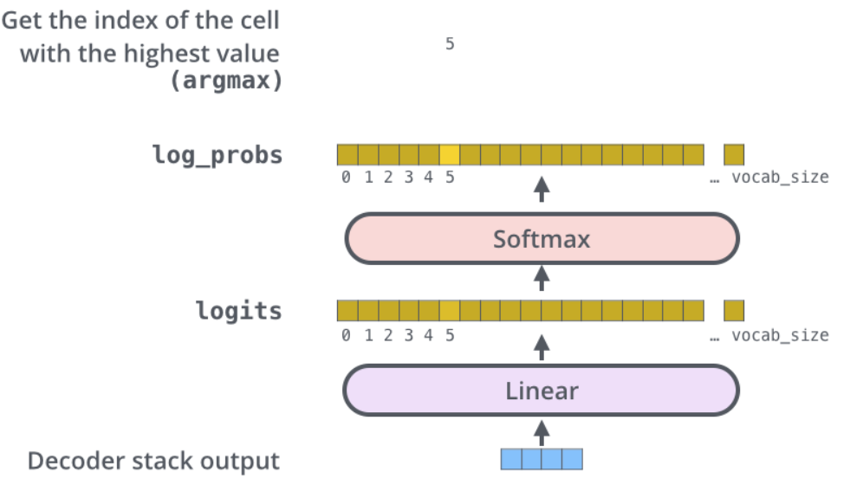
Final Linear Layer
Converts the Decoder output to the dictionary word.
Convert decoder output to much larger vector (vocab size).
Apply Softmax.
Related Work
Notes:
self-attention layer is only allowed to attend to earlier positions in the output sequence. This is done by masking future positions (setting them to -inf) before the softmax step in the self-attention calculation.
The “Encoder-Decoder Attention” layer works just like multiheaded self-attention, except it creates its Queries matrix from the layer below it, and takes the Keys and Values matrix from the output of the encoder stack.

Slide 48
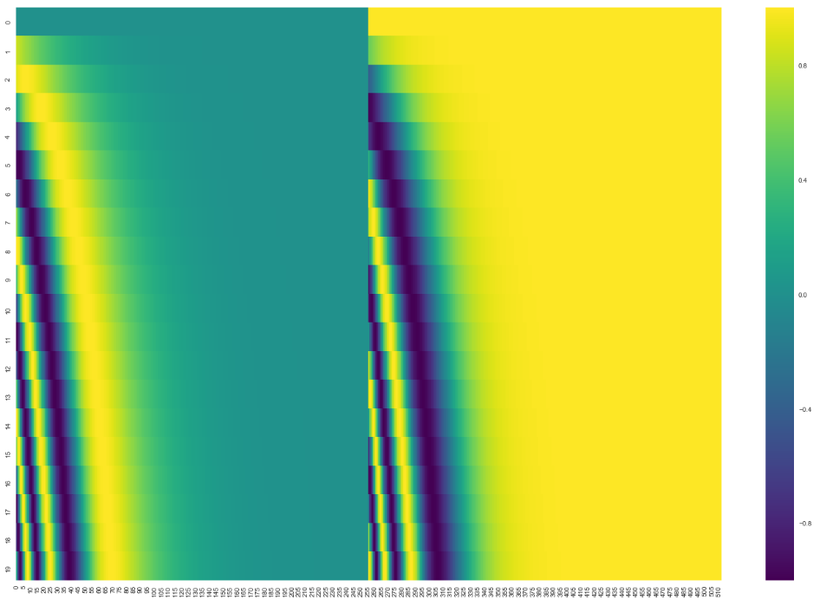
Position Encoding
Determine the position of each word, or the distance between different words in the sequence.
Related Work
Notes:
These vectors follow a specific pattern that the model learns, which helps it determine the position of each word, or the distance between different words in the sequence. The intuition here is that adding these values to the embeddings provides meaningful distances between the embedding vectors once they’re projected into Q/K/V vectors and during dot-product attention.

Slide 49
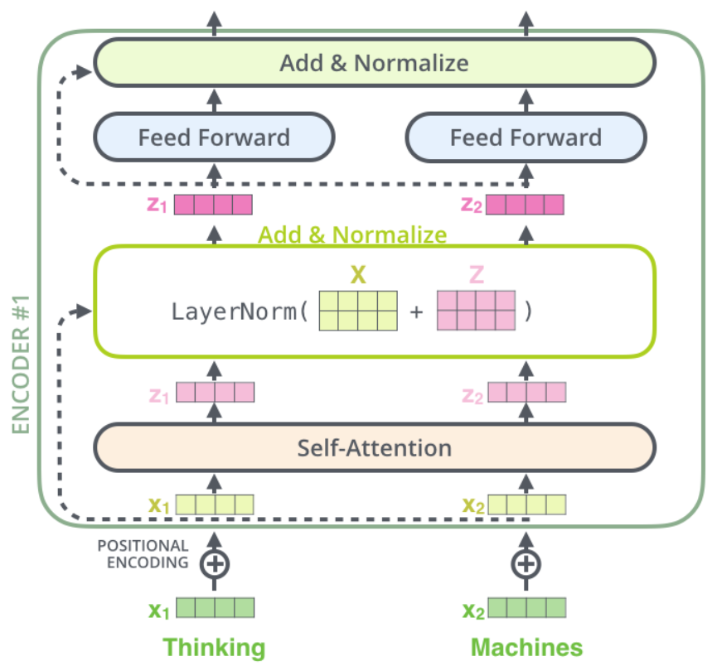
Encoder
Related Work

Slide 50
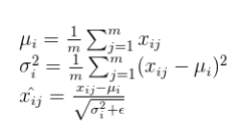
Layer Normalisation
Normalize across the layer.
Calculate Mean and Variance.
i represent each batch.
j represent the number of features in the layer.
Related Work

Slide 51
Decoder
Self-attention to only earlier positions in output sequence.
Use masking (-inf) for future positions.
Encoder-Decoder attention layer- K and V vector are output of Encoder.
Related Work
Notes:
self-attention layer is only allowed to attend to earlier positions in the output sequence. This is done by masking future positions (setting them to -inf) before the softmax step in the self-attention calculation.
The “Encoder-Decoder Attention” layer works just like multiheaded self-attention, except it creates its Queries matrix from the layer below it, and takes the Keys and Values matrix from the output of the encoder stack.

Slide 52
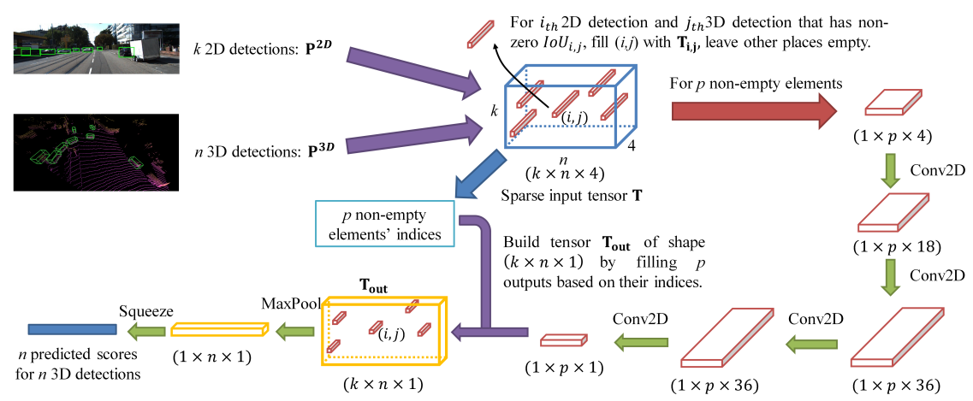
CLOCs
2D and 3D detections by some model.
CLOCs shows fusion technique.
Research Gaps
Notes:
self-attention layer is only allowed to attend to earlier positions in the output sequence. This is done by masking future positions (setting them to -inf) before the softmax step in the self-attention calculation.
The “Encoder-Decoder Attention” layer works just like multiheaded self-attention, except it creates its Queries matrix from the layer below it, and takes the Keys and Values matrix from the output of the encoder stack.

Slide 53


Generalised IoU Loss
C is the smallest convex object area. Smallest Convex object is calculated by first finding the minimum and maximum (x, y) coordinates, among all the coordinates of both bounding boxes, and then creating a convex object by joining minimum and maximum point coordinates.
Calculate a ratio between the volume (area) occupied by C excluding A and B and divide by the total volume (area) occupied by C. This represents a normalized measure that focuses on the empty volume (area) between A and B. Finally, GIoU is attained by subtracting this ratio from the IoU value.
GIoU works in non-overlapping scenario as well.
Related Work
Notes:
389 setreo image pair sequences and

Slide 54
Dataset: Kitti
Autonomous driving domain dataset captured in Karlsruhe Germany.
1.4 MP grayscale cameras: 2
1.4 MP color cameras: 2
Velodyne HDL-64E Laser scanner: 1, etc.
(1382*512) image resolution.
7481 images and 200K object 2D and 3D annotations.
For 2D detection evaluation, Kitti datatset uses Average Precision (AP) calculated by Intersection over Union (IoU) between predicted and ground truth bounding boxes.
Methodology
Notes:
389 setreo image pair sequences and

Slide 55


Dataset: Kitti Evaluation
Average Precision by area under Precision/Recall curve.
True Positive- overlap exceed 50%.
Duplicate predictions are False Positives.
Consider all data samples to calculate p/r curve.
Same as PASCAL VOC approach.
Methodology
Notes:
389 setreo image pair sequences and

Slide 56
Dataset: Kitti
Methodology
Notes:
389 setreo image pair sequences and

Slide 57
Dataset: NuScenes
Inspired from Kitti dataset.
Cameras: 6, LiDAR: 1 and RADAR: 5, etc.
(1600*900) image resolution.
1.4M RGB images and 3D annotations only.
For evaluation NuScenes uses mean AP (mAP), calculated by finding distance between center of predicted and ground truth bounding boxes.
Methodology
Notes:
It calculates AP by finding 2D distance between the centre of predictions and ground truth bounding boxes. Then, classify them as TP and FP for different threshold distance (0.5, 1, 2, 4, in meters) values and take mean over all classes.

Slide 58
Dataset: NuScenes Evaluation
Mean AP (mAP)
Calculated by finding distance between 2D center of predicted and ground truth bounding boxes.
Match predictions with the ground truth objects that have the smallest center-distance up to a certain threshold.
For every threshold plot p/r curve.
Threshold values: {0.5, 1, 2, 4} meters.
Average over all threshold matches
Mean across all classes.
Methodology
Notes:
It calculates AP by finding 2D distance between the centre of predictions and ground truth bounding boxes. Then, classify them as TP and FP for different threshold distance (0.5, 1, 2, 4, in meters) values and take mean over all classes.

Slide 59

Dataset: NuScenes
Methodology
Notes:
It calculates AP by finding 2D distance between the centre of predictions and ground truth bounding boxes. Then, classify them as TP and FP for different threshold distance (0.5, 1, 2, 4, in meters) values and take mean over all classes.

Slide 60


Kitti to COCO
Kitti
COCO
Methodology
Notes:
It calculates AP by finding 2D distance between the centre of predictions and ground truth bounding boxes. Then, classify them as TP and FP for different threshold distance (0.5, 1, 2, 4, in meters) values and take mean over all classes.

Slide 61



Kitti to COCO
Kitti mapping to COCO.
Methodology
Notes:
It calculates AP by finding 2D distance between the centre of predictions and ground truth bounding boxes. Then, classify them as TP and FP for different threshold distance (0.5, 1, 2, 4, in meters) values and take mean over all classes.

Slide 62


Faster- RCNN
RPN
Methodology
Notes:
It calculates AP by finding 2D distance between the centre of predictions and ground truth bounding boxes. Then, classify them as TP and FP for different threshold distance (0.5, 1, 2, 4, in meters) values and take mean over all classes.

Slide 63

YOLO
Anchor boxes: multiple object center in same grid cell.
NMS
Methodology
Notes:
It calculates AP by finding 2D distance between the centre of predictions and ground truth bounding boxes. Then, classify them as TP and FP for different threshold distance (0.5, 1, 2, 4, in meters) values and take mean over all classes.

Slide 64



TransFuserDeTr Model
Using Kitti dataset (split 1).
Data Augmentation (Row 6, also reduced generalisation gap).
Experiments
Notes:
L1 and GIoU loss have NO generalization gap after Data Augmentation.

Slide 65


TransFuserDeTr Model
Using Kitti dataset (split 1).
Experiments

Slide 66

TransFuserDeTr Model
Experiments

Slide 67

SOTA Comparison
Comparison between TransFuserDeTr model and SOTA on Kitti dataset.
For Pedestrian : TransFuserDeTr performs better than all SOTA (except DeTr).
For Car : TransFuserDeTr performs better results than DeTr.
For Cyclist : TransFuserDeTr performs better than AVOD and AVOD-FPN.
Pretrained TransFuserDeTr on NuScenes, improved AP₇₀ for Pedestrian and Cyclist classes.
[9]
[9]
[11]
[12]
[8]
Experiments
Notes:
Pretrained TransFuserDeTr on NuScenes, improved AP₇₀ for Pedestrian and Cyclist classes –
Reason: Probably because Car already has enough data thus model already learned car details very well.
But for Pedestrian and Cyclist the data is already very less in Kitti thus model learned from Nuscenes dataset hence improved the performance.
But only improved by small margin probably because the data distribution of NuS and Kitti is different. Hence, doesn’t increase much.

Slide 68

AVOD
Aggregate View Object Detection
Qualitative Results
Notes:
Labels: 0:Car, 1: Van, 4: Pedestrain and 6: Cyclist

Slide 69

AVOD - FPN
High resolution Feature Extractor in AVOD model.
Qualitative Results
Notes:
Labels: 0:Car, 1: Van, 4: Pedestrain and 6: Cyclist

Slide 70

Fast-CLOCs
Fast Camera-LIDAR Object Candidates Fusion
3D and 2D Feature Fusion
RoI Alignment
Qualitative Results
Notes:
Labels: 0:Car, 1: Van, 4: Pedestrain and 6: Cyclist

Slide 71

PFF3D
Point Wise Feature Fusion for 3D Object Detection
Point Transform Module which projects point cloud on the RGB image and generate image point features.
Qualitative Results
Notes:
Labels: 0:Car, 1: Van, 4: Pedestrain and 6: Cyclist

Slide 72

PointPainting
Qualitative Results
Notes:
Labels: 0:Car, 1: Van, 4: Pedestrain and 6: Cyclist

Slide 73


Qualitative Results
Effect of training data and object size: far Cyclist is not predicted but farther Car is predicted.
Qualitative Results
Notes:
Labels: 0:Car, 1: Van, 4: Pedestrain and 6: Cyclist

Slide 74

Qualitative Results
Sometimes, TransFuserDeTr model predicted traffic cone as Pedestrian with such high confidence (didn‘t happen in DeTr).
Possible reason: Same representation for both in LIDAR BEV image.
LIDAR BEV data is playing significant role.
Possible reason for increasing validation loss and still increasing AP value.
Qualitative Results

Slide 75



Qualitative Results
LIDAR BEV data plays significant role in detection.
Qualitative Results

